Slide 1
Musical Money Box
Soham Sud - 7.5
Brief: To make a money box
i)Must Hold Money
ii)Must be a wooden box
iii)Must be made using different joints

Slide 2
How to make a MMB- 1st Brainstorm: What do I need?
Soham Sud - 7.5
Skills:
Be able to make joints.
Be able to use saw/s.
Be able to correctly edit my work at the end.
Knowledge:
Know which joints to make.
Know my measurements.
Know what saws are needed for different type of jobs.
Tools:
Saws
Measuring tape
Glue
Materials:
Wood - Pine
MDF
Abrasive Paper

Slide 3
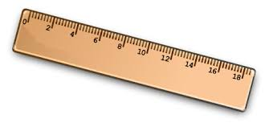
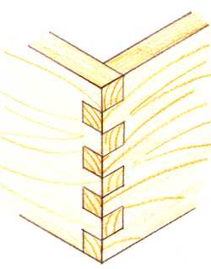
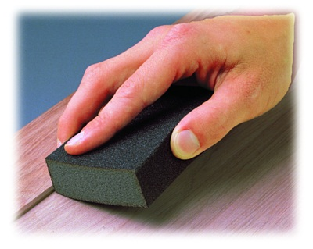
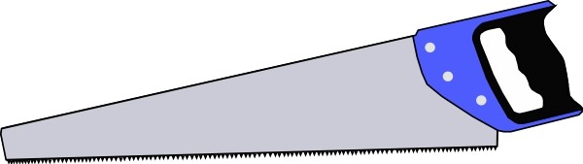
2nd Brainstorm: Skills
Soham Sud - 7.5
Measure
Jointing
Sanding
Cutting

Slide 4
Jointing
Soham Sud - 7.5
Jointing
The method used for joining wood will depend on the function, strength and quality of the product.
Wood joints can be made with frame joints, such as butt joints, halving joints, dovetail and box joints.
Butt joint
Dovetail joint
Finger joint
Doweled joint
Lap joint

Slide 5


Slide 6
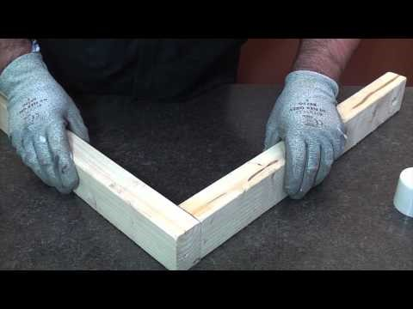
Butt Joint
Soham Sud - 7.5
Butt Joint
A butt joint is nothing more than when one piece of wood butts into another (most often at a right angle, or square to the other board) and is fastened using mechanical fasteners.
Joints Slide

Slide 7
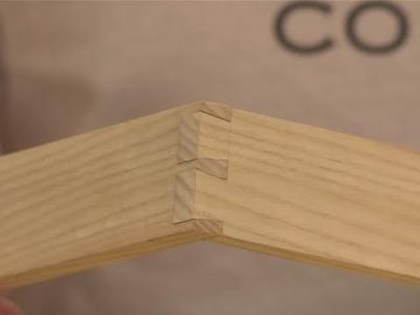
Dovetail joint
Soham Sud - 7.5
Dove tail Joints
Dovetail joints are commonly used to build boxes, drawers, and cabinets. The shape of the "tails and pins" in the joint make it nearly impossible to break. Glue is used to strengthen the joint but no screws or fasteners are necessary.
Joints Slide

Slide 8
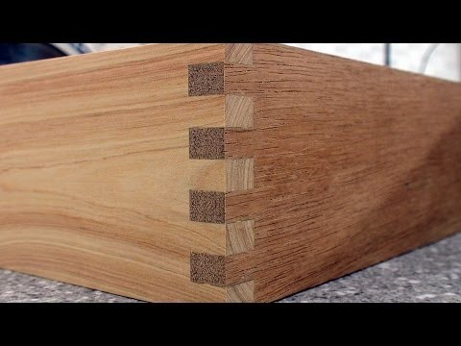
Finger Joint
Soham Sud - 7.5
Finger Joint
A finger joint, also known as a comb or box joint, is a woodworking joint made by cutting a set of complementary rectangular cuts in two pieces of wood, which are then glued. To visualize a finger joint simply interlock the fingers of your hands at a ninety degree angle; hence the name "finger joint."
Joints Slide

Slide 9
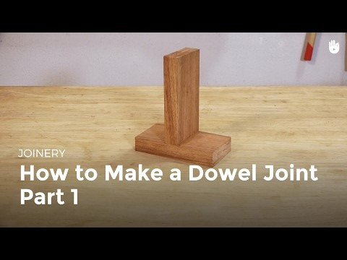
Doweled Joint
Soham Sud - 7.5
Dowled Joint
This type of joint is secured with an adhesive and a small piece of dowel. Construction also requires nothing more than a drill and some accurate markings.
Joints Slide

Slide 10
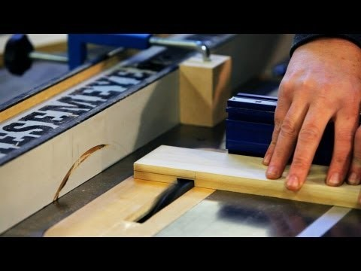
Lap Joint
Soham Sud - 7.5
Lap Joint
A lap joint is just two mating notches, one of the simplest joints there is. But if you apply glue and clamp the surfaces together very tightly, it is also very strong.
Joints Slide

Slide 11
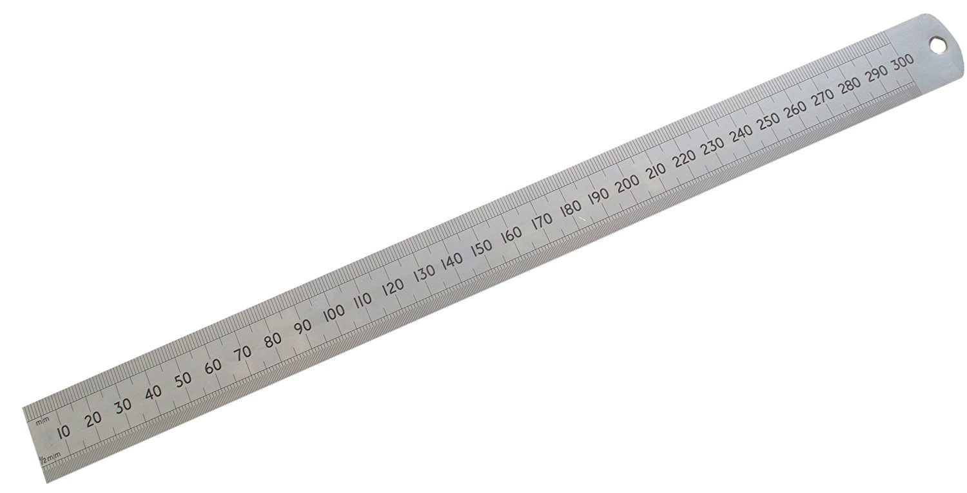
Measuring
Soham Sud - 7.5
Measuring
Measuring is the first step in woodworking. The second step is to make a mark on the measured point. The combination of the two processes—measuring and marking—forms the foundation of accurate work. If either is done incorrectly, much effort and material are wasted.
Mr Elphicks tips on Measuring!
Always use a ruler
Use a pencil to mark as you could make a mistake
Measure twice, cut once!
Soham Sud - 7.5

Slide 12
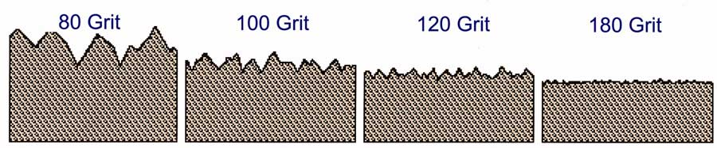
Sanding
Soham Sud - 7.5
Sanding
Sanding and preparing wood before staining will help your staining project go faster and easier. The grade, or grit, of sandpaper is based on the number of sand granules per square inch of paper. The higher the number, the finer the grade. Lower-numbered grades denote coarser sandpaper.
Here are the grades

Slide 13
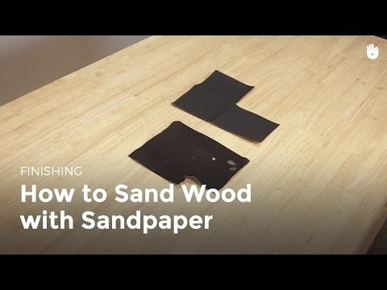

Slide 14
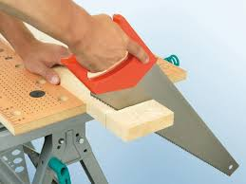
Cutting
Soham Sud - 7.5
Cutting
Make the starting cut. When you make the first cut, use your thumb or the knuckle of your thumb on the hand holding the wood as a guide to ensure you cut along the cutline.
Stand like an archer!
Hold like a gangster!

Slide 15
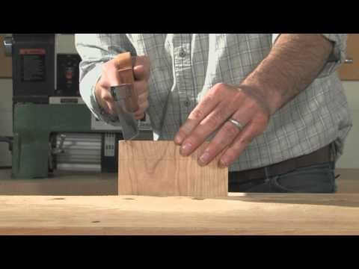

Slide 16
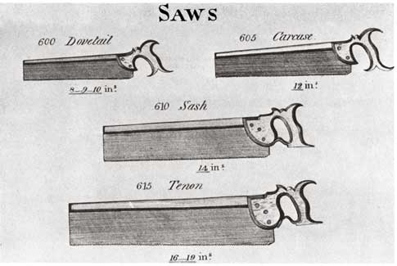
Soham Sud - 7.5

Slide 17
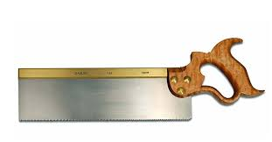
Tenon Saw
Tenon Saw
A Tenon saw has a relatively short blade and a stiff spine running along its back ideal for making straight precise cuts. Tenon saws are most commonly used for making the Tenon's used in mortise and Tenon joints, hence the name.
Soham Sud - 7.5

Slide 18
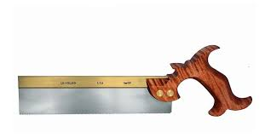
Dovetail Saw
Dovetail Saw
Dovetail saws are used for applications that require small, very precise cuts or when an extremely neat finish is required. They are typically used for joint-making, particularly dovetail joints, where two pieces of wood must fit together precisely.
Soham Sud - 7.5

Slide 19
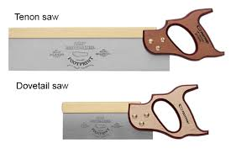
Don’t get confused!!!!!!!!!!!!!!!!
Soham Sud - 7.5

Slide 20
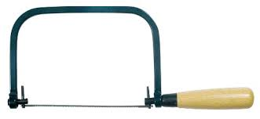
Coping Saw
Coping Saw
A coping saw has a thin blade stretched between a U-shaped frame and attached to a handle. The blade is designed to be removed from the frame.
Coping saws are designed for very delicate cutting applications (e.g., making intricate shapes or curved lines). They are often used to shape the edges of wooden moulding, or when creating joints.
Soham Sud - 7.5

Slide 21
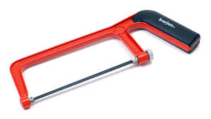
Hack Saw
Hack Saw
The hacksaw is a saw with a narrow fine-toothed blade set in a frame,
used to cut steel and other metals. It can also be used to cut plastics, although it is not normally used to cut woods. It is sometimes called an adjustable hacksaw because the length of the frame can be altered to hold blades of different sizes.
Soham Sud - 7.5

Slide 22
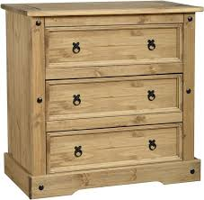
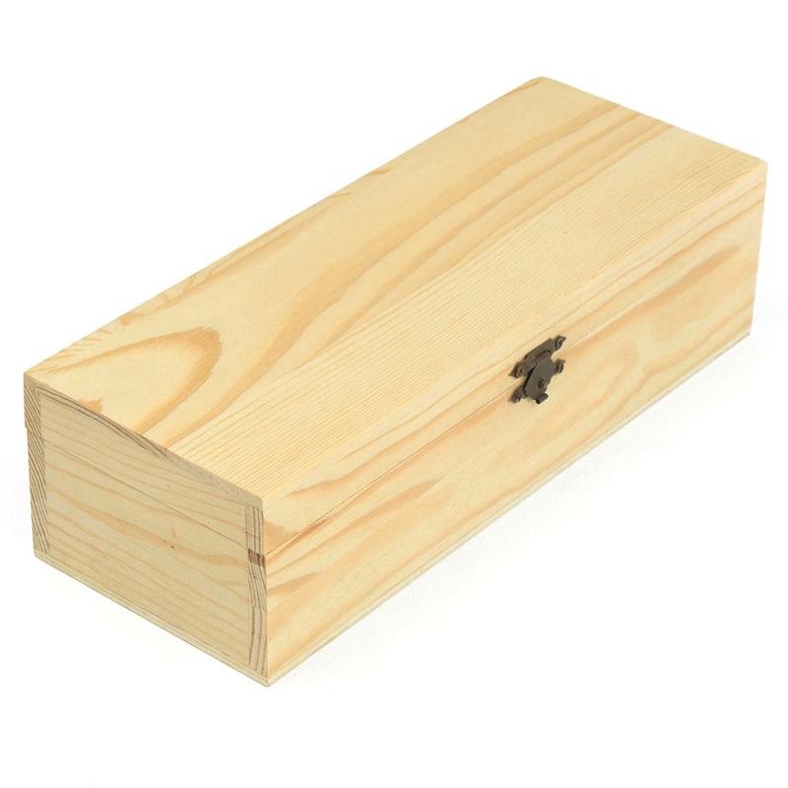
Pine
Pine:
Pine is an inexpensive, lightweight wood that can be yellowish or whitish with brown knots. It's low-cost, and it takes paint well, so it's great for kids' furniture.
Soham Sud - 7.5

Slide 23
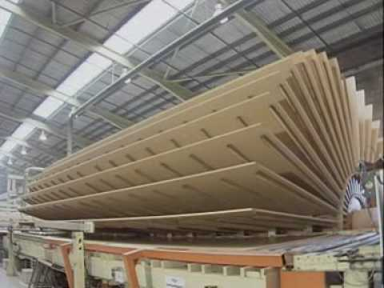
MDF
MDF:
Medium-density fibreboard (MDF) is an engineered wood product made by breaking down hardwood or softwood residuals into wood fibres, often in a defibrator, combining it with wax and a resin binder, and forming panels by applying high temperature and pressure. MDF is generally denser than plywood.
Soham Sud - 7.5

Slide 24
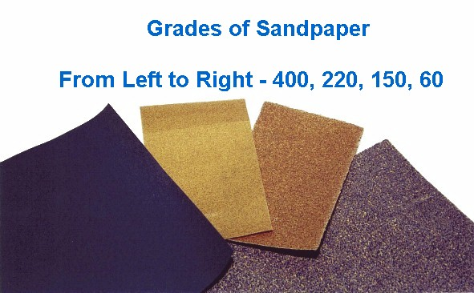
Abrasive paper
Soham Sud - 7.5
Sandpaper or glass paper are names used for a type of coated abrasive that consists of sheets of paper or cloth with abrasive material glued to one face.

Slide 25
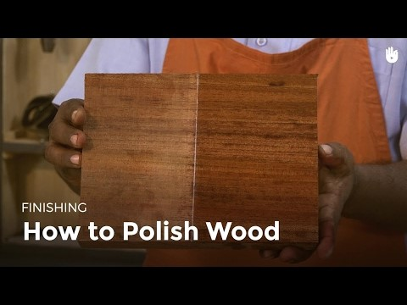

Slide 26
Bibliography
Soham Sud - 7.5
http://www.instructables.com/id/How-to-Measure-and-Mark-with-Precision/
http://www.artofmanliness.com/2009/11/03/toolmanship-how-to-use-a-handsaw/
http://www.diynetwork.com/how-to/skills-and-know-how/painting/sanding-and-preparing-wood-before-staining
http://www.bbc.co.uk/schools/gcsebitesize/design/resistantmaterials/materialcomponentadhesiverev3.shtml
https://www.thespruce.com/wood-joinery-types-3536631
http://www.woodworkbasics.com/dowel-joint.html
http://www.startwoodworking.com/post/lap-joint-basics
http://www.popularmechanics.com/home/how-to-plans/how-to/a19197/how-to-cut-dovetail-joints-woodworking/
https://en.wikipedia.org/wiki/Finger_joint
https://www.wonkeedonkeetools.co.uk/handsaws/what-is-a-tenon-saw/
https://www.wonkeedonkeetools.co.uk/handsaws/what-is-a-dovetail-saw/
https://www.wonkeedonkeetools.co.uk/handsaws/what-is-a-coping-saw/
https://en.wikipedia.org/wiki/Medium-density_fibreboard
https://en.wikipedia.org/wiki/Emery_cloth
https://www.realsimple.com/home-organizing/decorating/different-types-wood/pine

Slide 27
A SPECIAL THANKS TO:
FABLAB.BLOG,
BBC BITESIZE,
TECHNOLOGY STUDENT

Slide 28

Thanks for watching!
Soham Sud - 7.5

