Slide 1
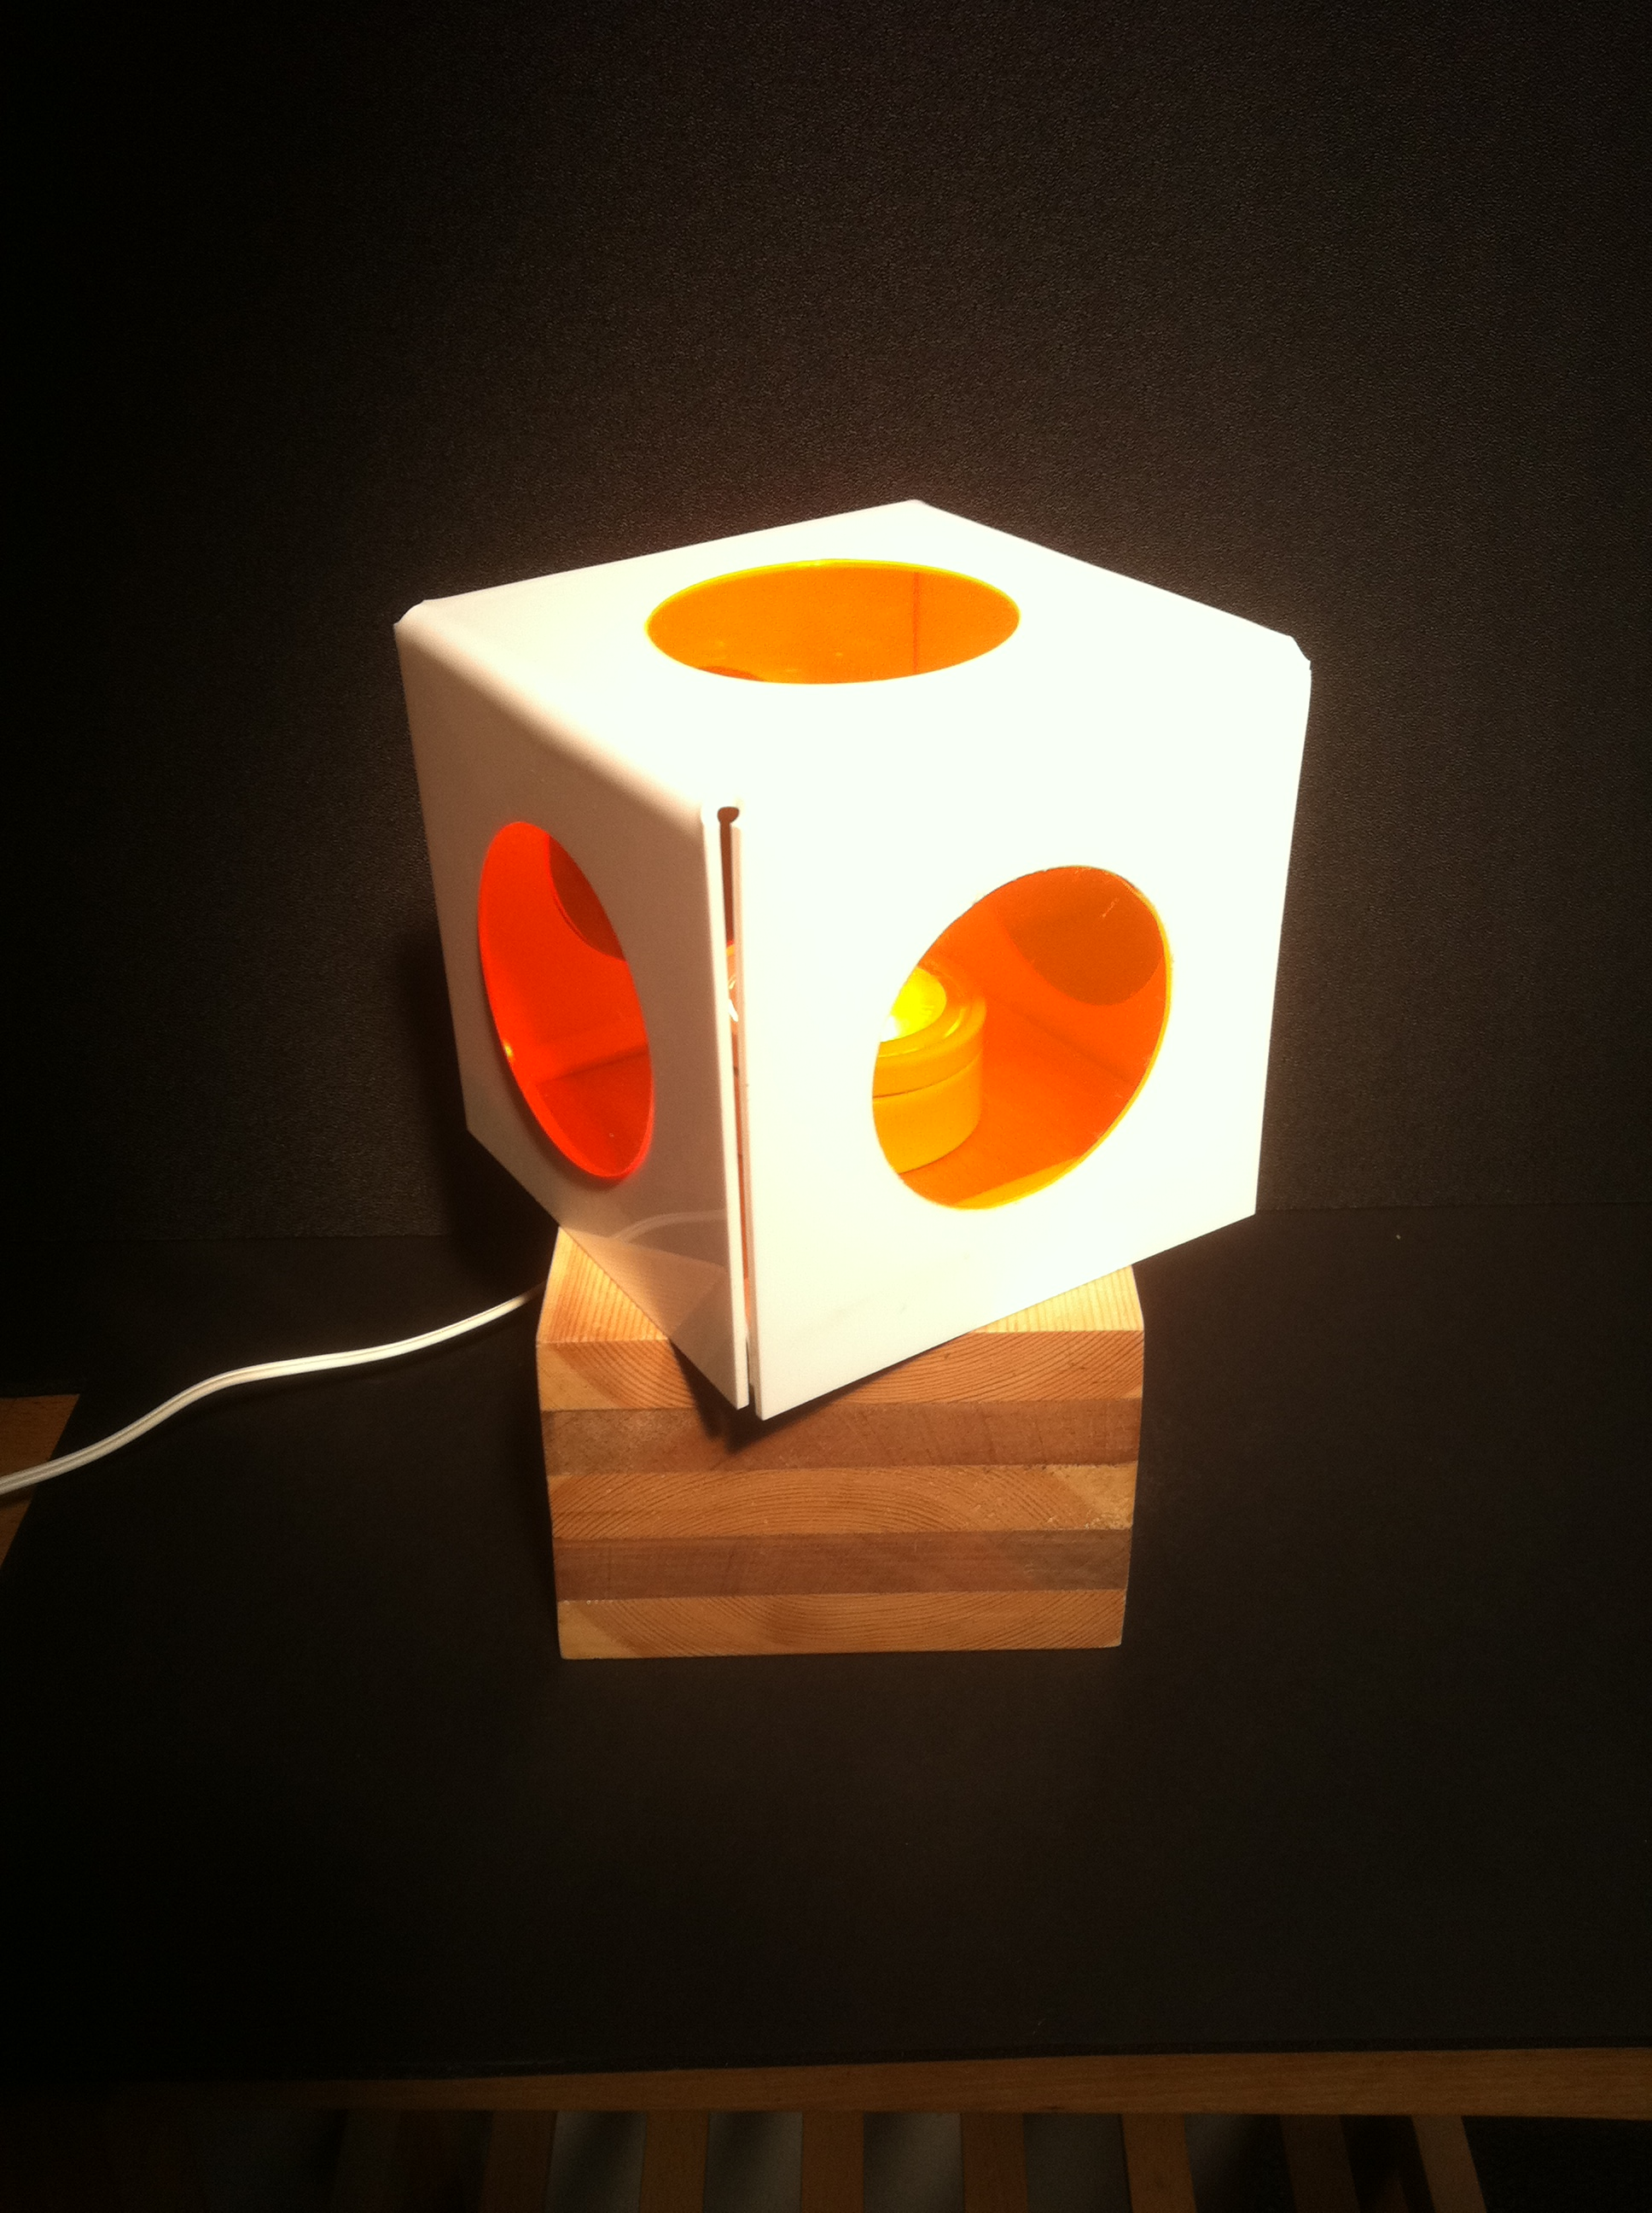
PIR / LED Lamp
PHASE 1
1.1 The Brief / Analysis of the Brief
1.2 Target Market Research
1.3 Product Analysis using ACCESS FM
1.4 Ergonomics & Anthropometrics
1.5 Materials Research
1.6 Specification using ACCESS FM
PHASE 2
2.1 Initial Ideas – annotated Sketches
PHASE 3
3.1 Develop Ideas – Annotated SketcheS
3.2 Develop Ideas – Modelling
PHASE 4
4.1 Technical Drawing
4.2 Presentation Drawing and/or
4.3 3D Modelling/ Inventor/Sketch up etc
PHASE 5
5.1 Works Schedule /Parts LIST
5.2 PRODUCTION
5.3 Evaluation against Specification using ACCESS FM
5.4 Photos of Final Design

Slide 2
Design Process
Phase 1
Phase 2
Phase 3
Phase 4
Phase 5
Identify Customer Needs
Design Brief
Concept
Development
Final Design
Production
Design Specification

Slide 3
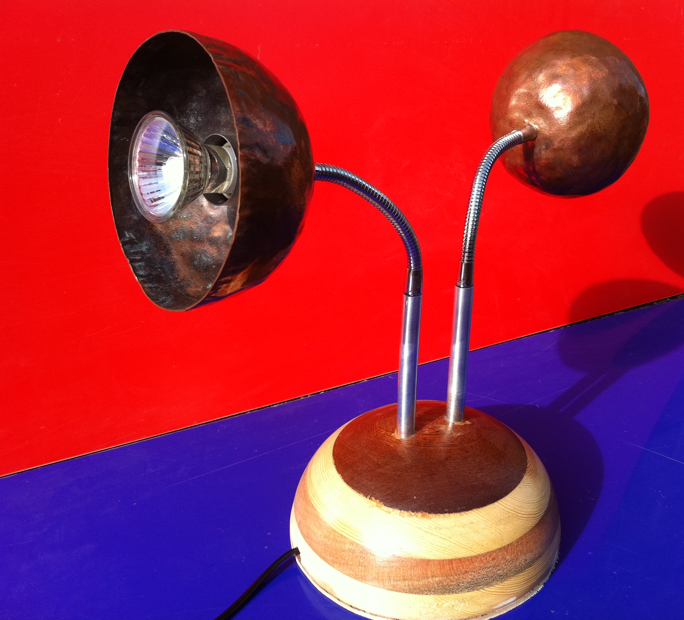
1.1 The Design Brief
Is a description of the problem to be solved or the product to be designed. This often includes key functions, but avoids implying specific concepts.
Design and make a LED lamp that uses a programmable PIR to turn it on and off.
Always keep an open mind at this stage of a project. Green light thinking…anything is possible!

Slide 4
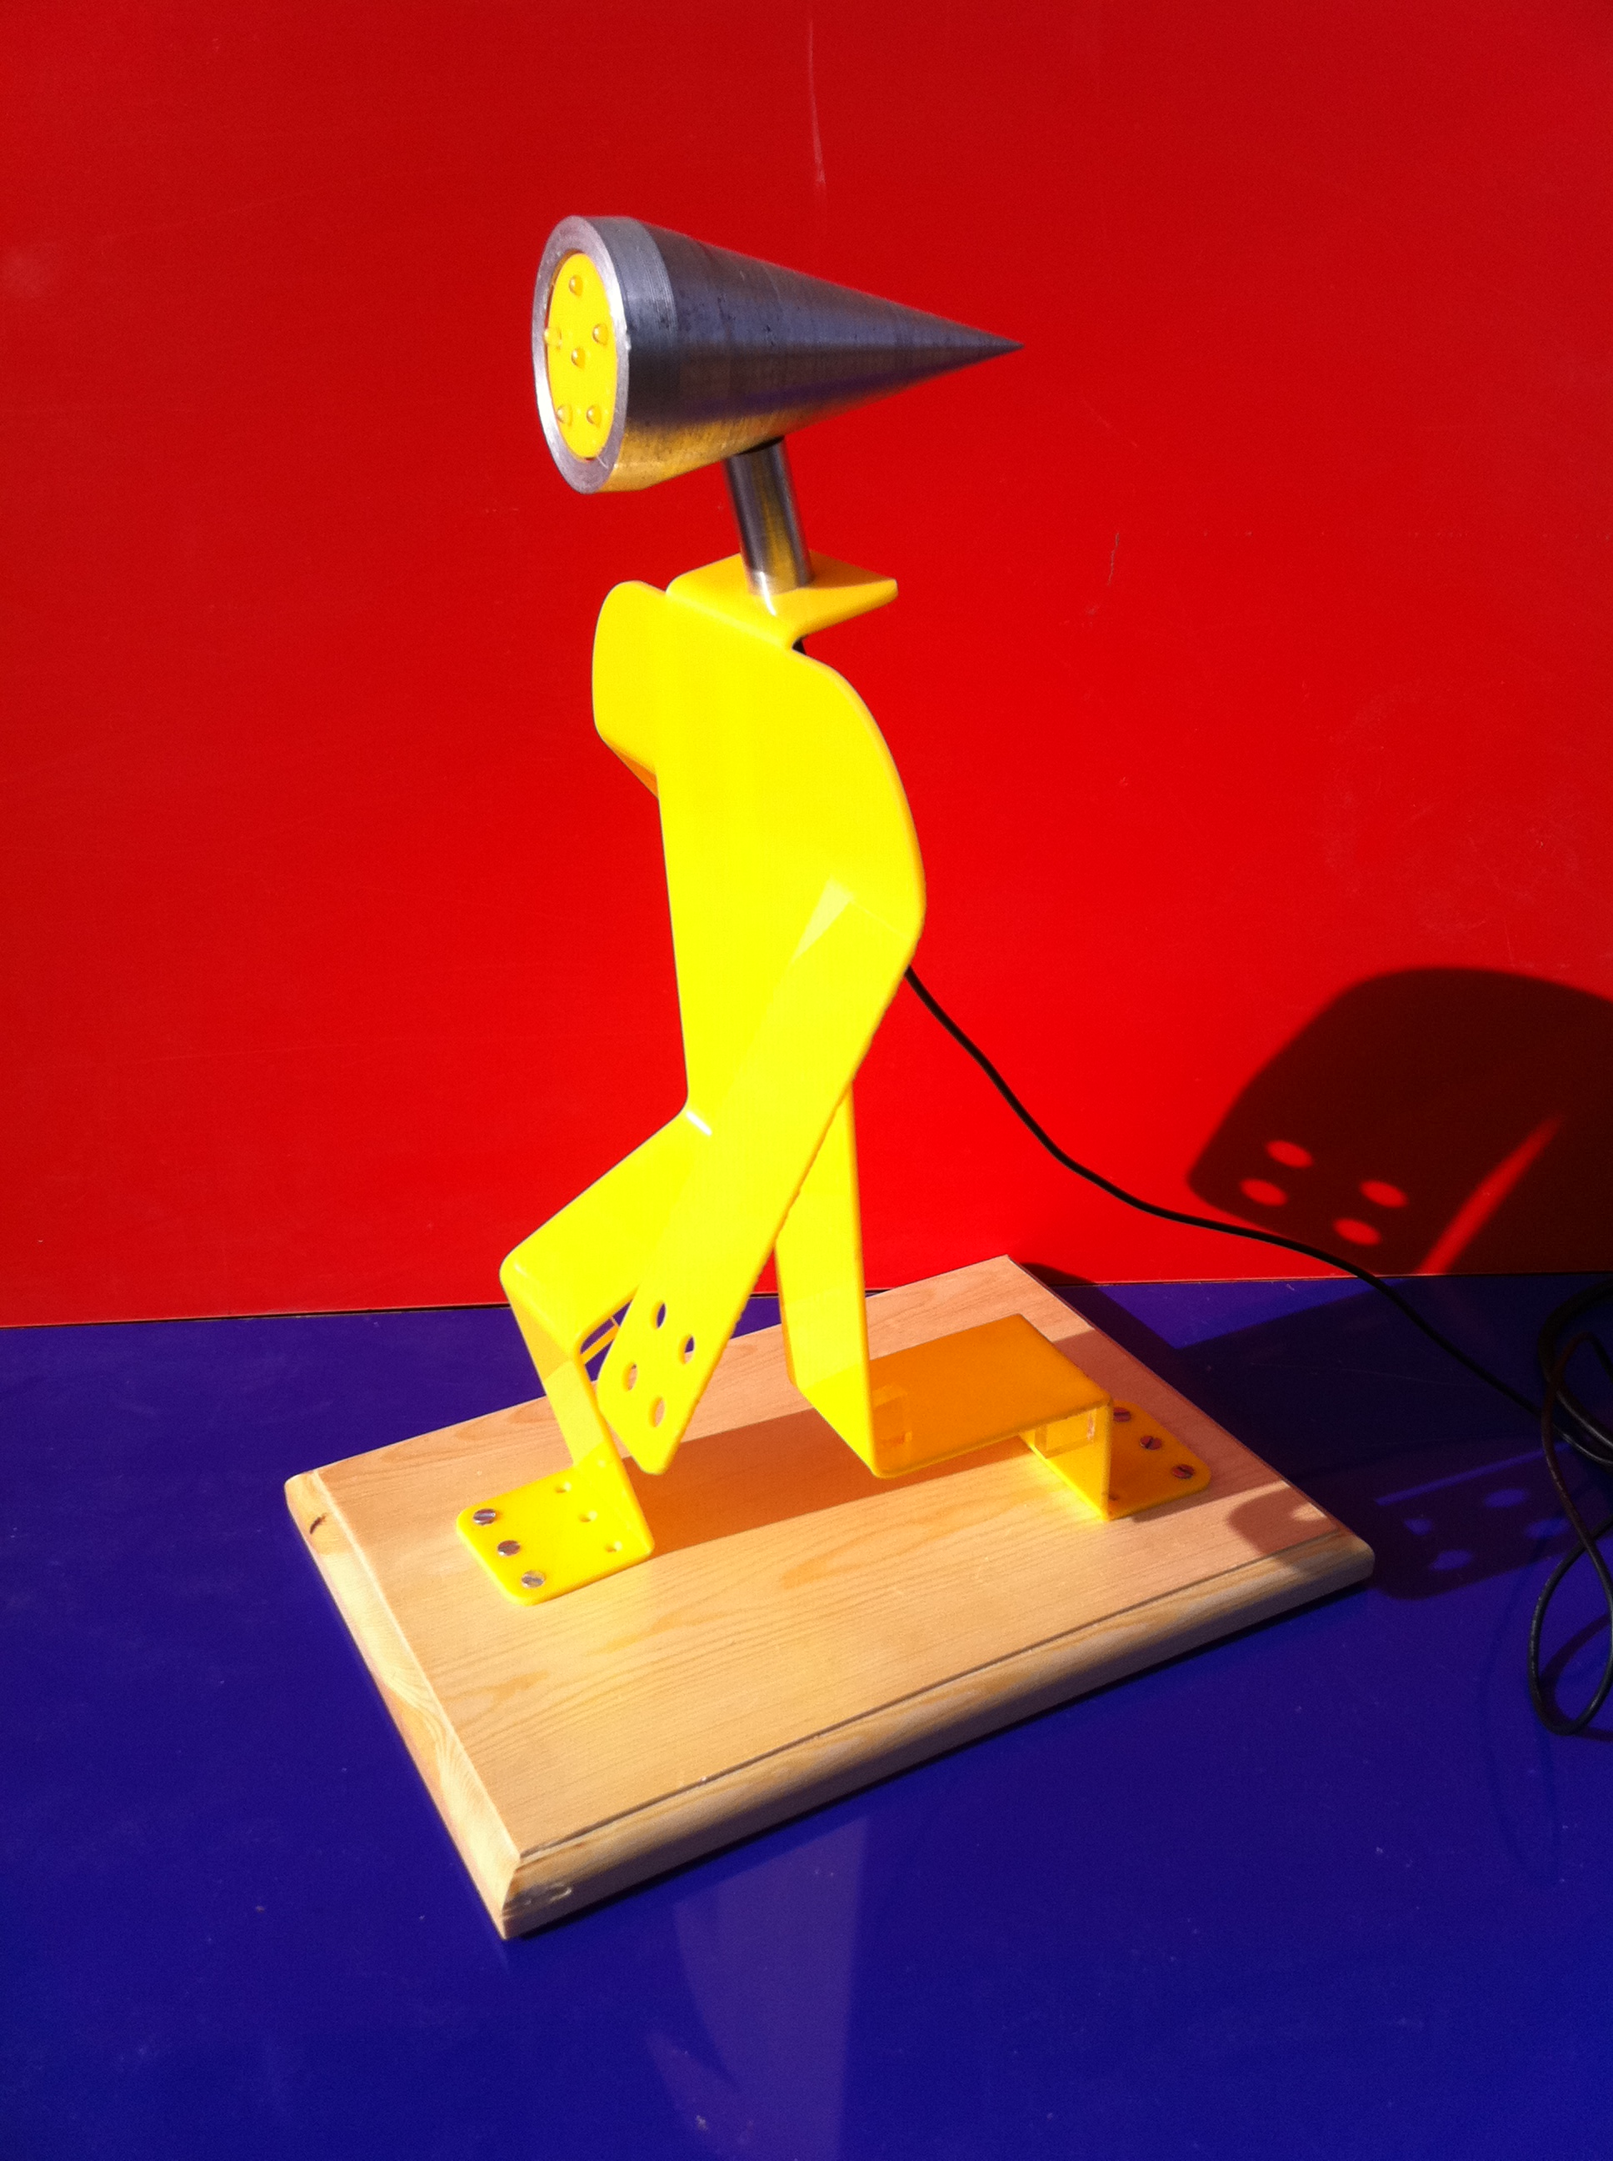
Market push or pull
Market Pull
Begin with a market opportunity, and develop a product to meet customer needs
Technology Push
Begin with a new technology, and find an appropriate market
In this example it’s MARKET PUSH: new programmable PIR technology combined with high intensity LED’s

Slide 5
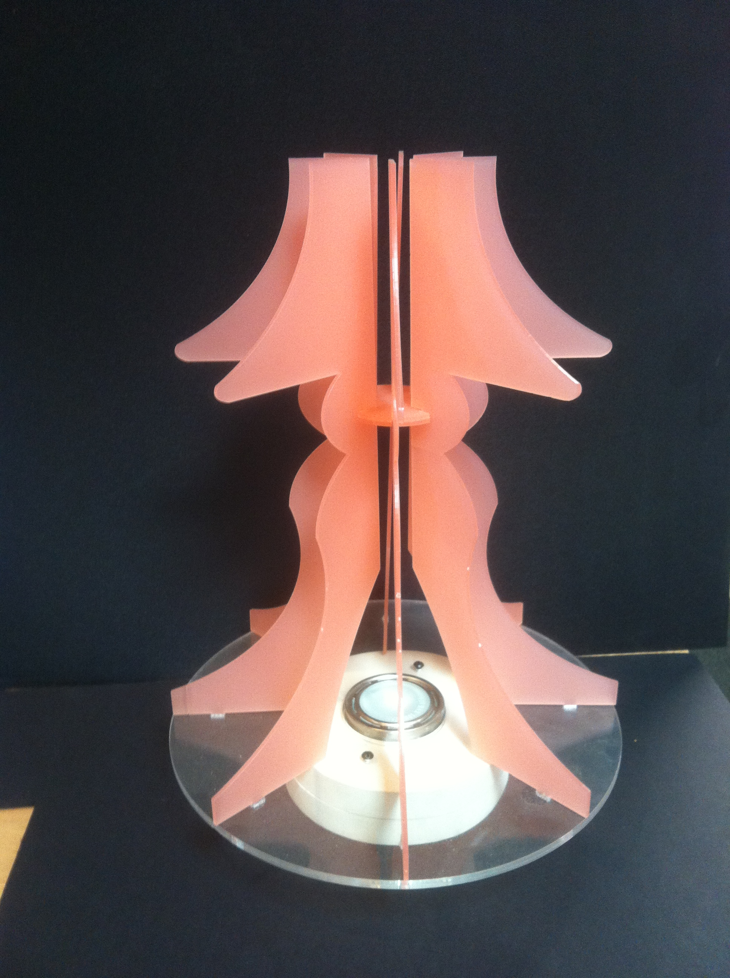
1.2 Defining your Target Market group
All products must focus on the client. Identifying who they are and what their needs are accurately is essential
Define your client, and their needs, in as many relevant ways as possible:
Male/Female
Age
Income
How they interact with your product
Etc, etc…

Slide 6
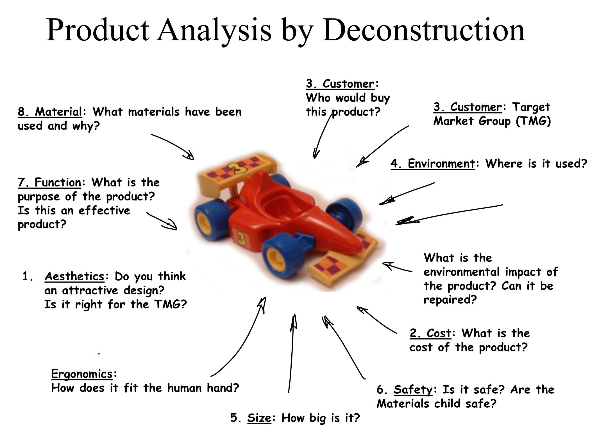
1.3 Product analysis – access fm
Using the following:
Aesthetics
Cost
Customer
Environment
Size
Safety
Function
Materials

Slide 7
1.4 Ergonomics and anthroprometrics
Anthropometrics: The study (measurement) of the human body and its movements.
Ergonomics: The study of people and their relationship with the environment around them.
You use Anthropometric Data to make something that is Ergonomic.

Slide 8
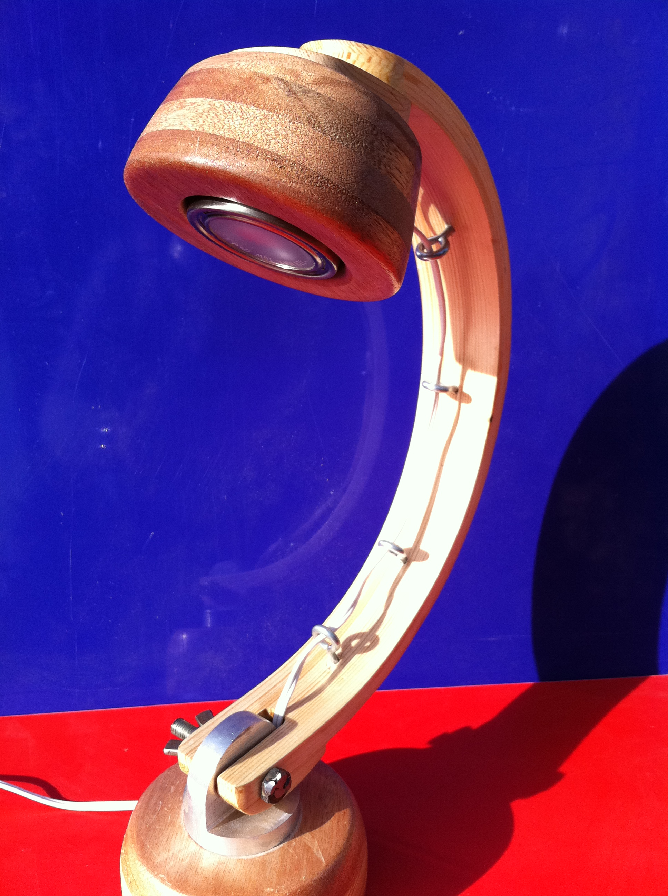
1.5 Materials research
Different materials have different properties. Physical properties such as strength and flexibility or aesthetic properties such as attractiveness and quality. Materials you may use are:
Wood
Metals
Plastic
Unique Electronic Components
YOU ARE NOT expected to learn about every material. It would be too much but you are expected to research into the materials you plan to use.

Slide 9
1.6 Product specification – access fm
Using the following to help define your product:
Aesthetics
Cost
Customer
Environment
Size
Safety
Function
Materials

Slide 10
2.1 INITIAL IDEAS /Annotated SKETCHES
Fast and furious! This is where you can show off your drawing and rendering skills.

Slide 11
3.1 developed ideas / annotated drawings
More annotated drawing and rendering but showing the development of your ideas.

Slide 12
3.2 developed ideas / 3d Modelling
Create a 3D model of you product – this could be in foam, card, balsa, clay – vertually any type of material to give you a realistic scale version of your final product.

Slide 13
4.1 Final product Drawing
This can be a combination of traditional technical drawing and/or CAD.
3rd Angle Orthographic
Isometric Projection
Google Sketch Up
Autodesk Inventor
Prodesktop, CREO etc.

Slide 14
5.1 production
Basically this is like baking a cake:
Schedule of Work (The recipe)
Parts List (The List of Ingredients)
Making (The Baking)
Evaluation of product against the original Specification (The Tasting)

Slide 15
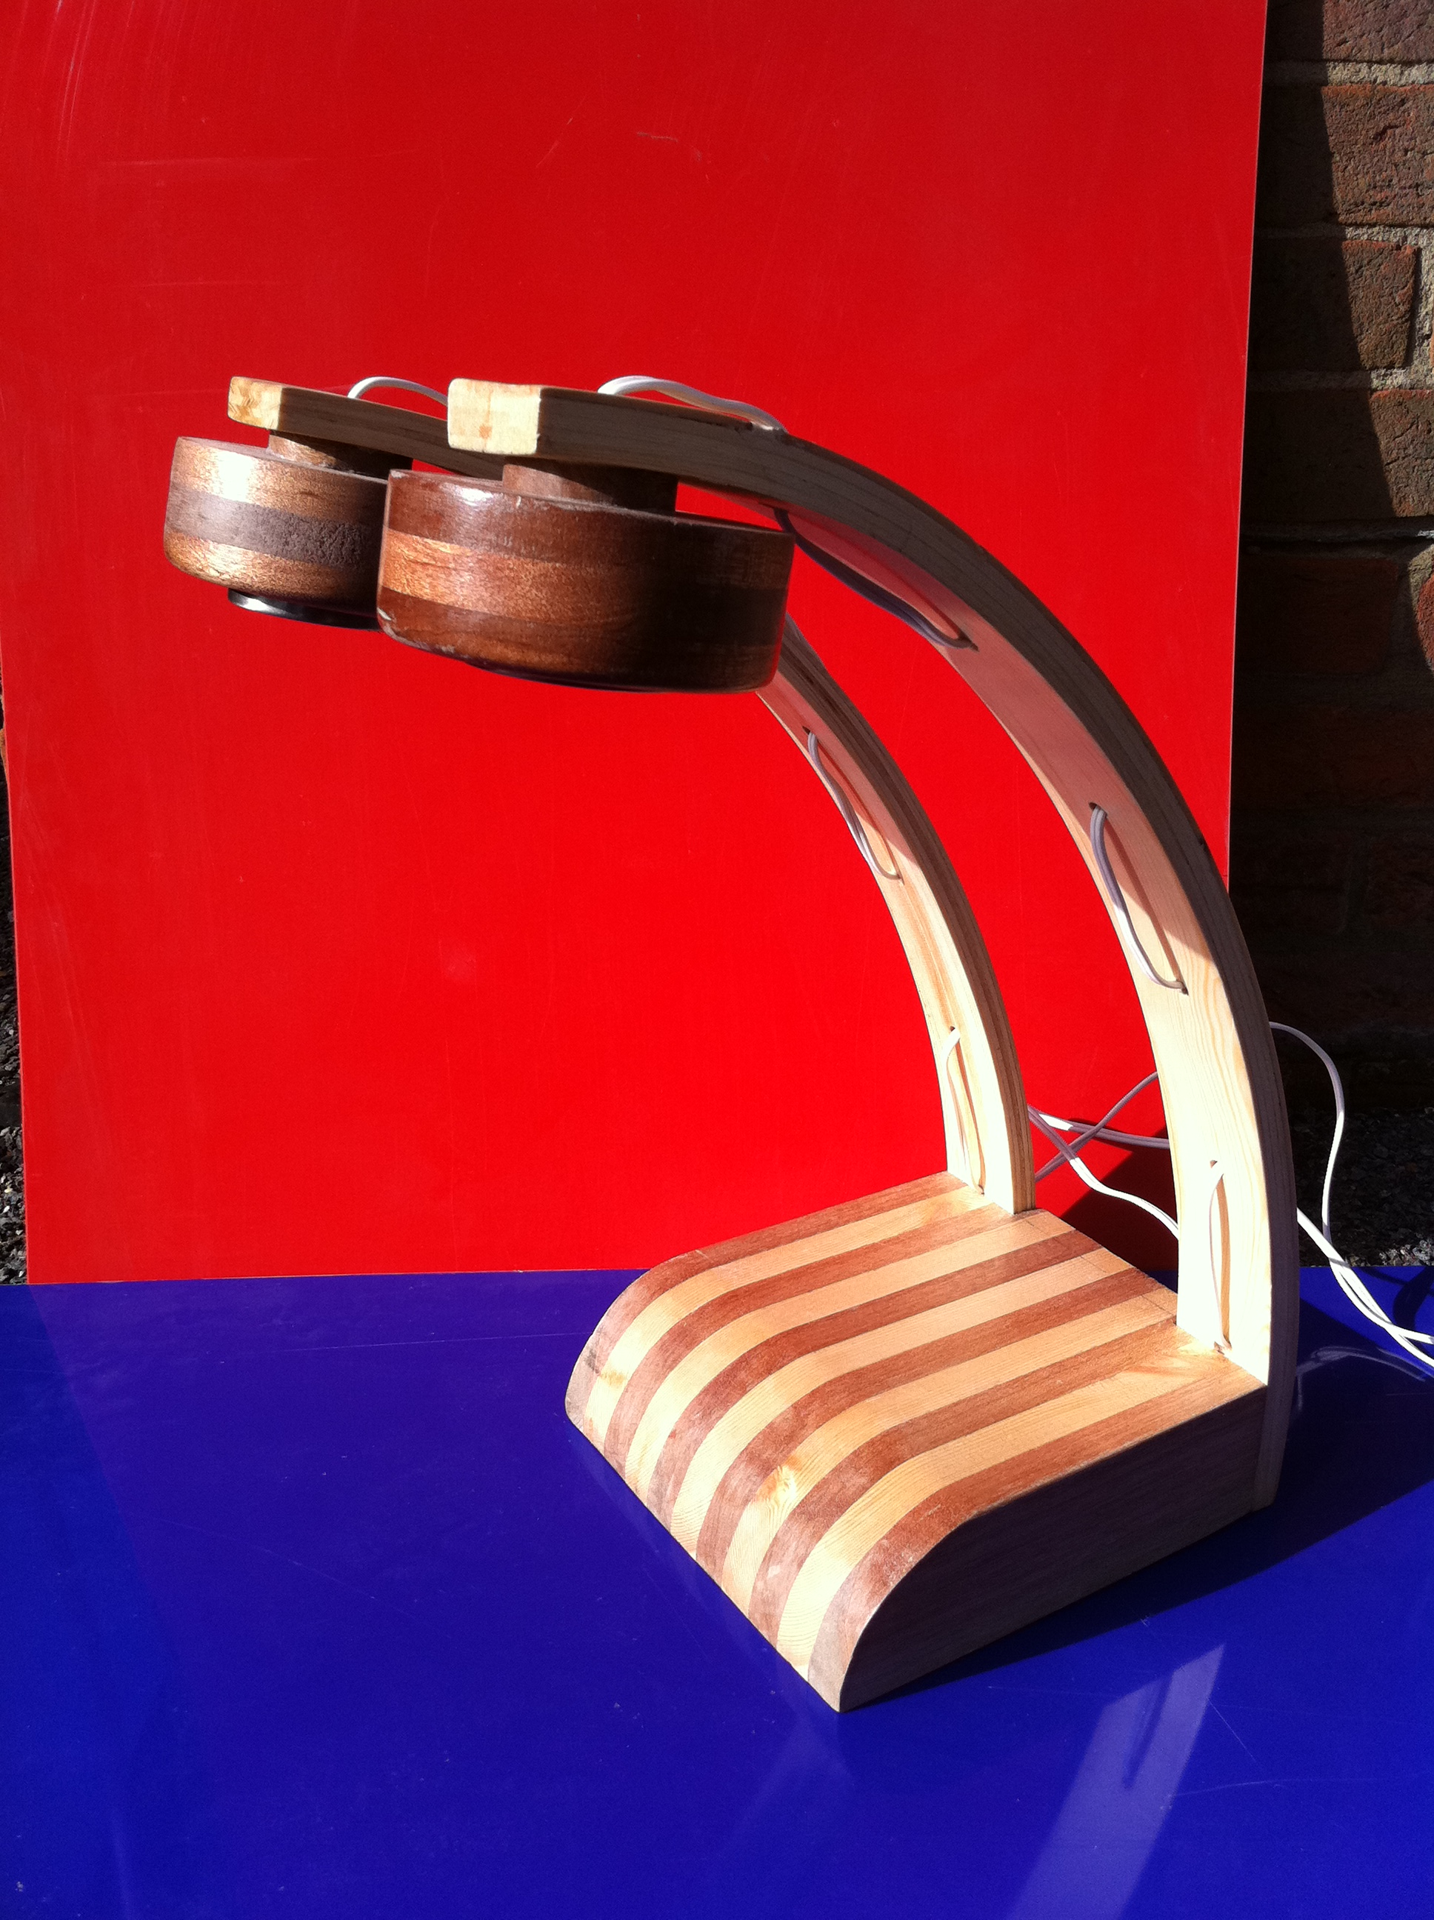
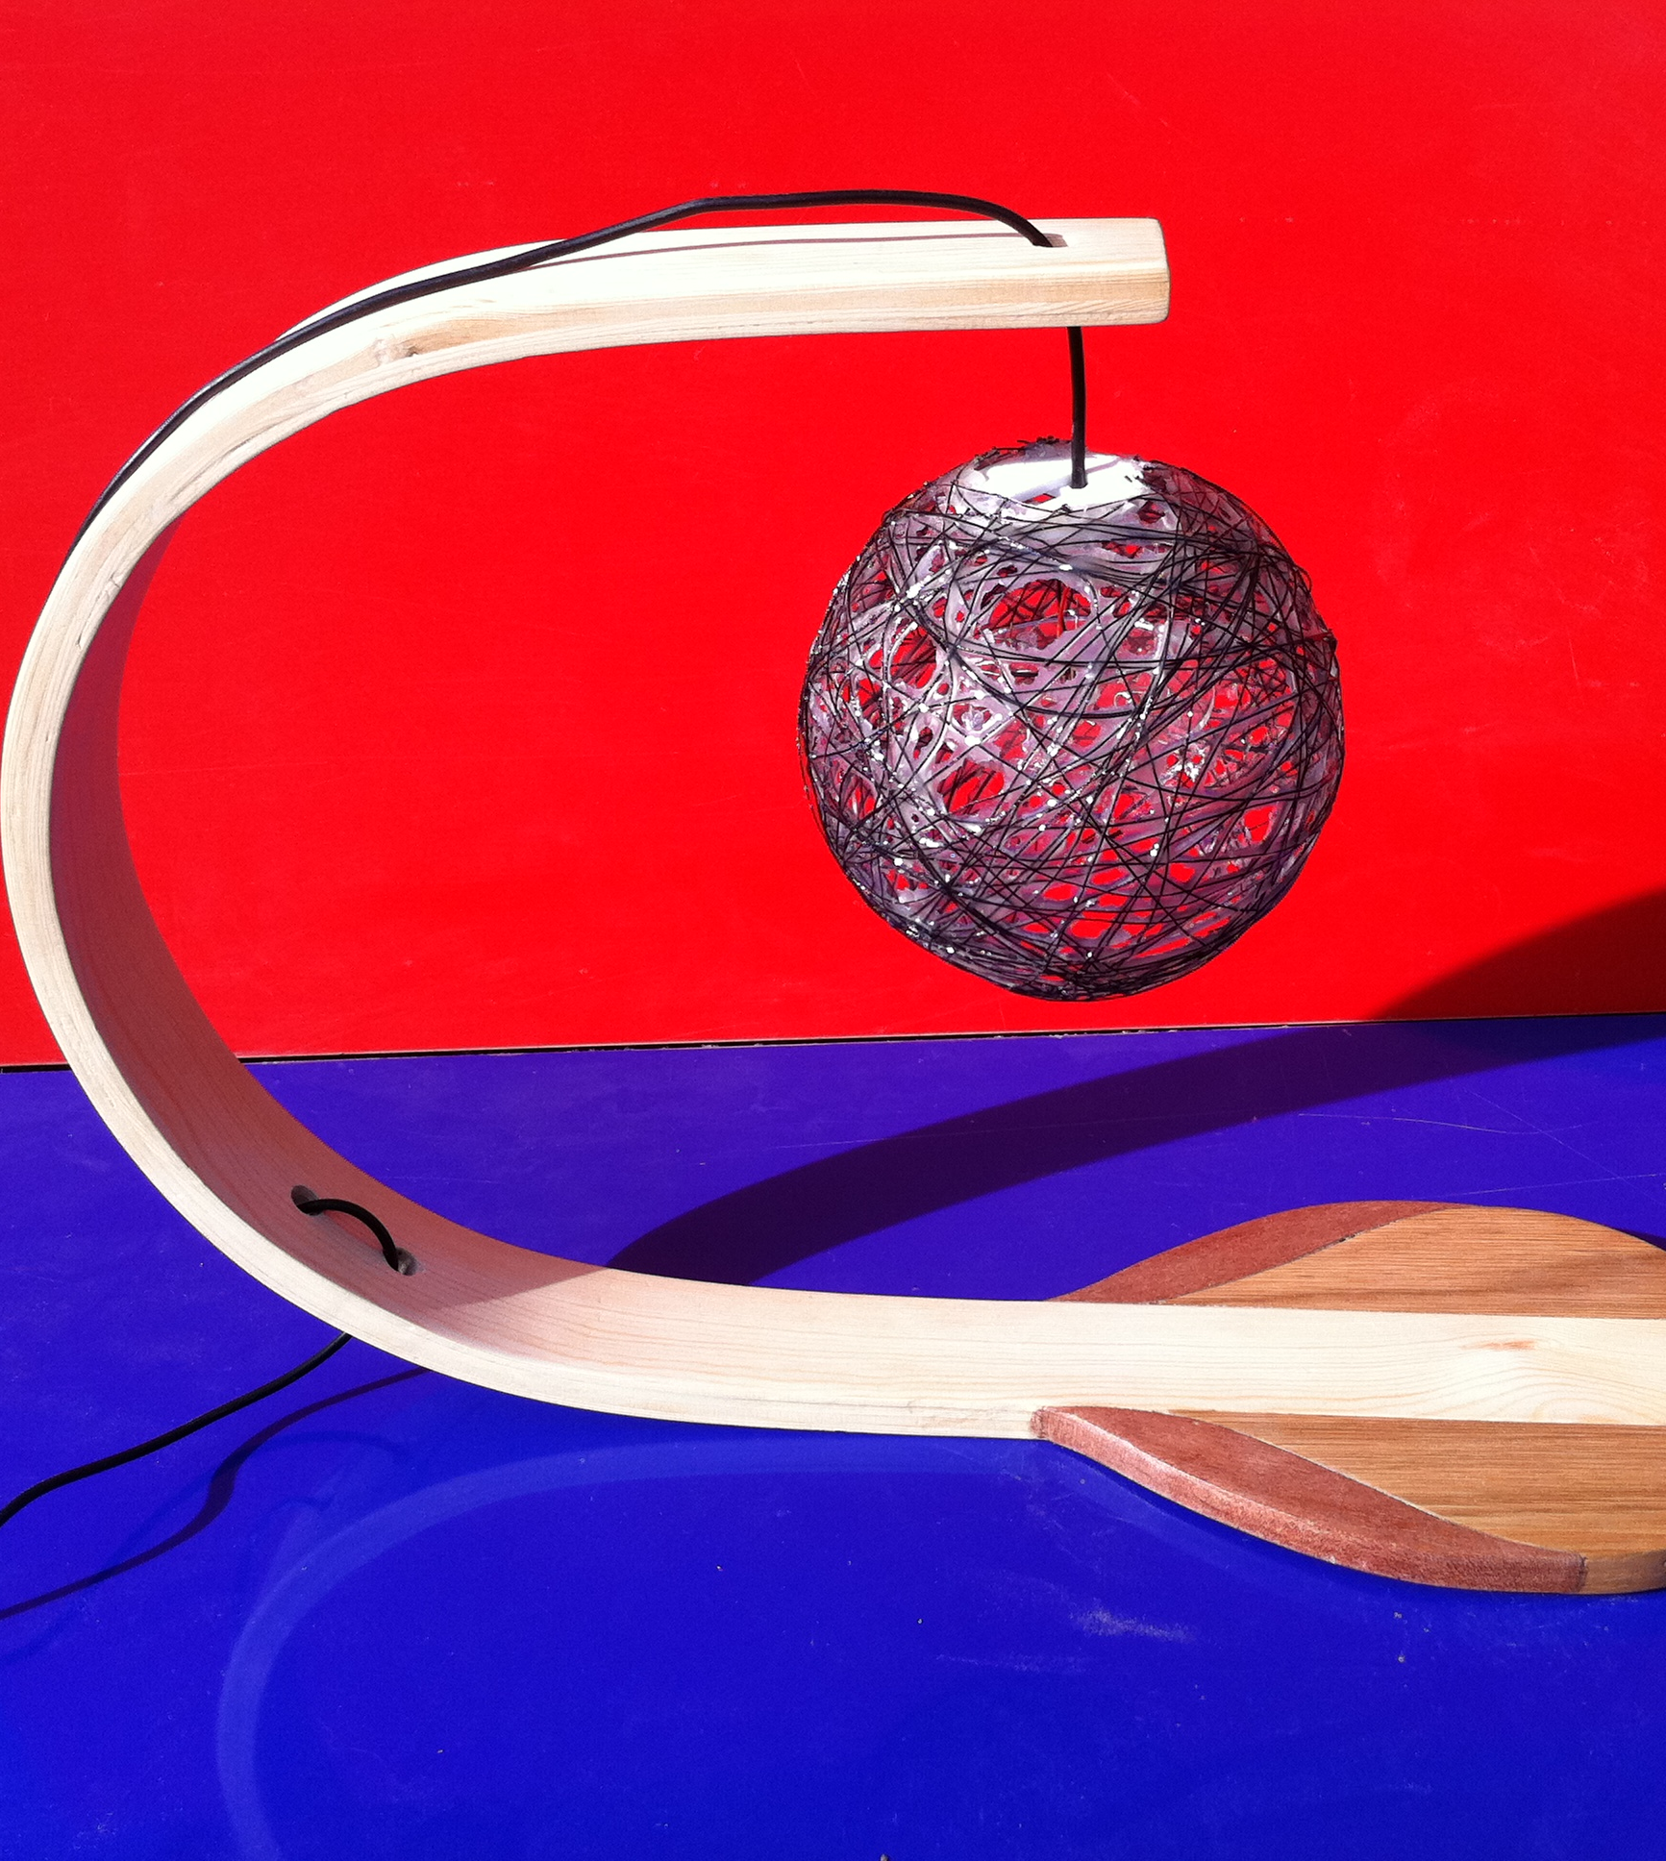
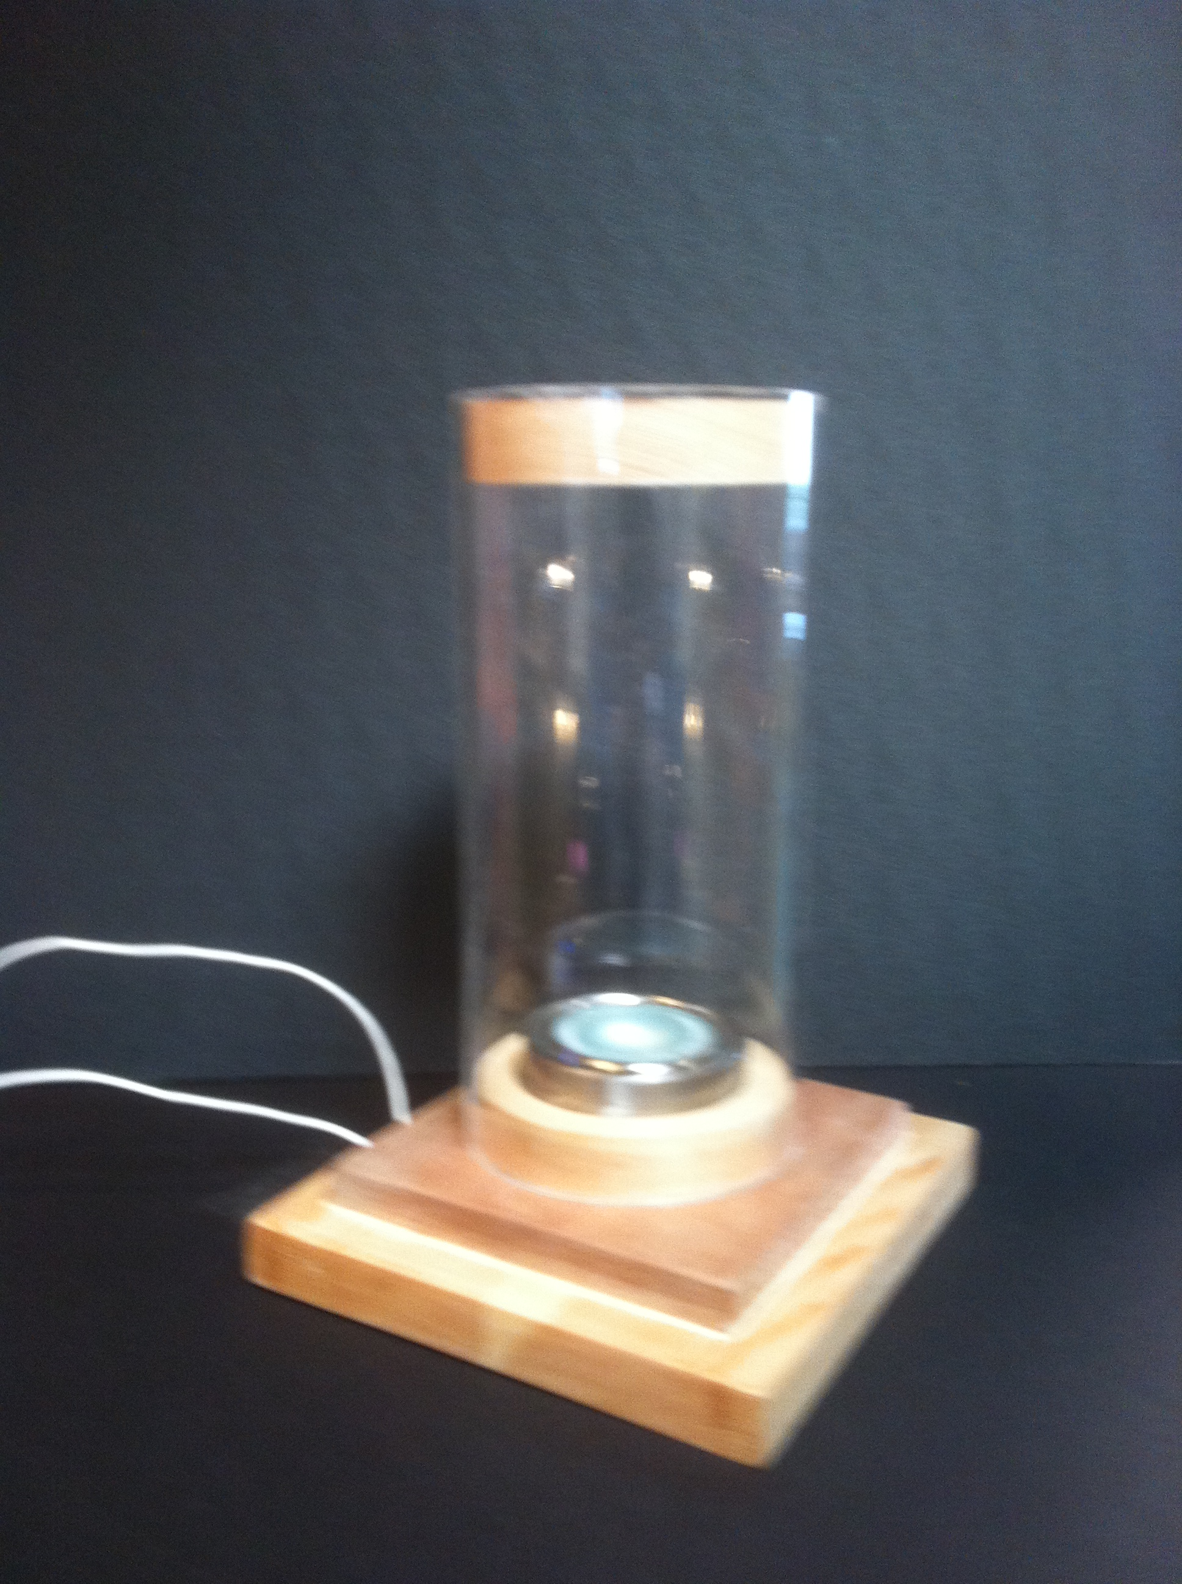
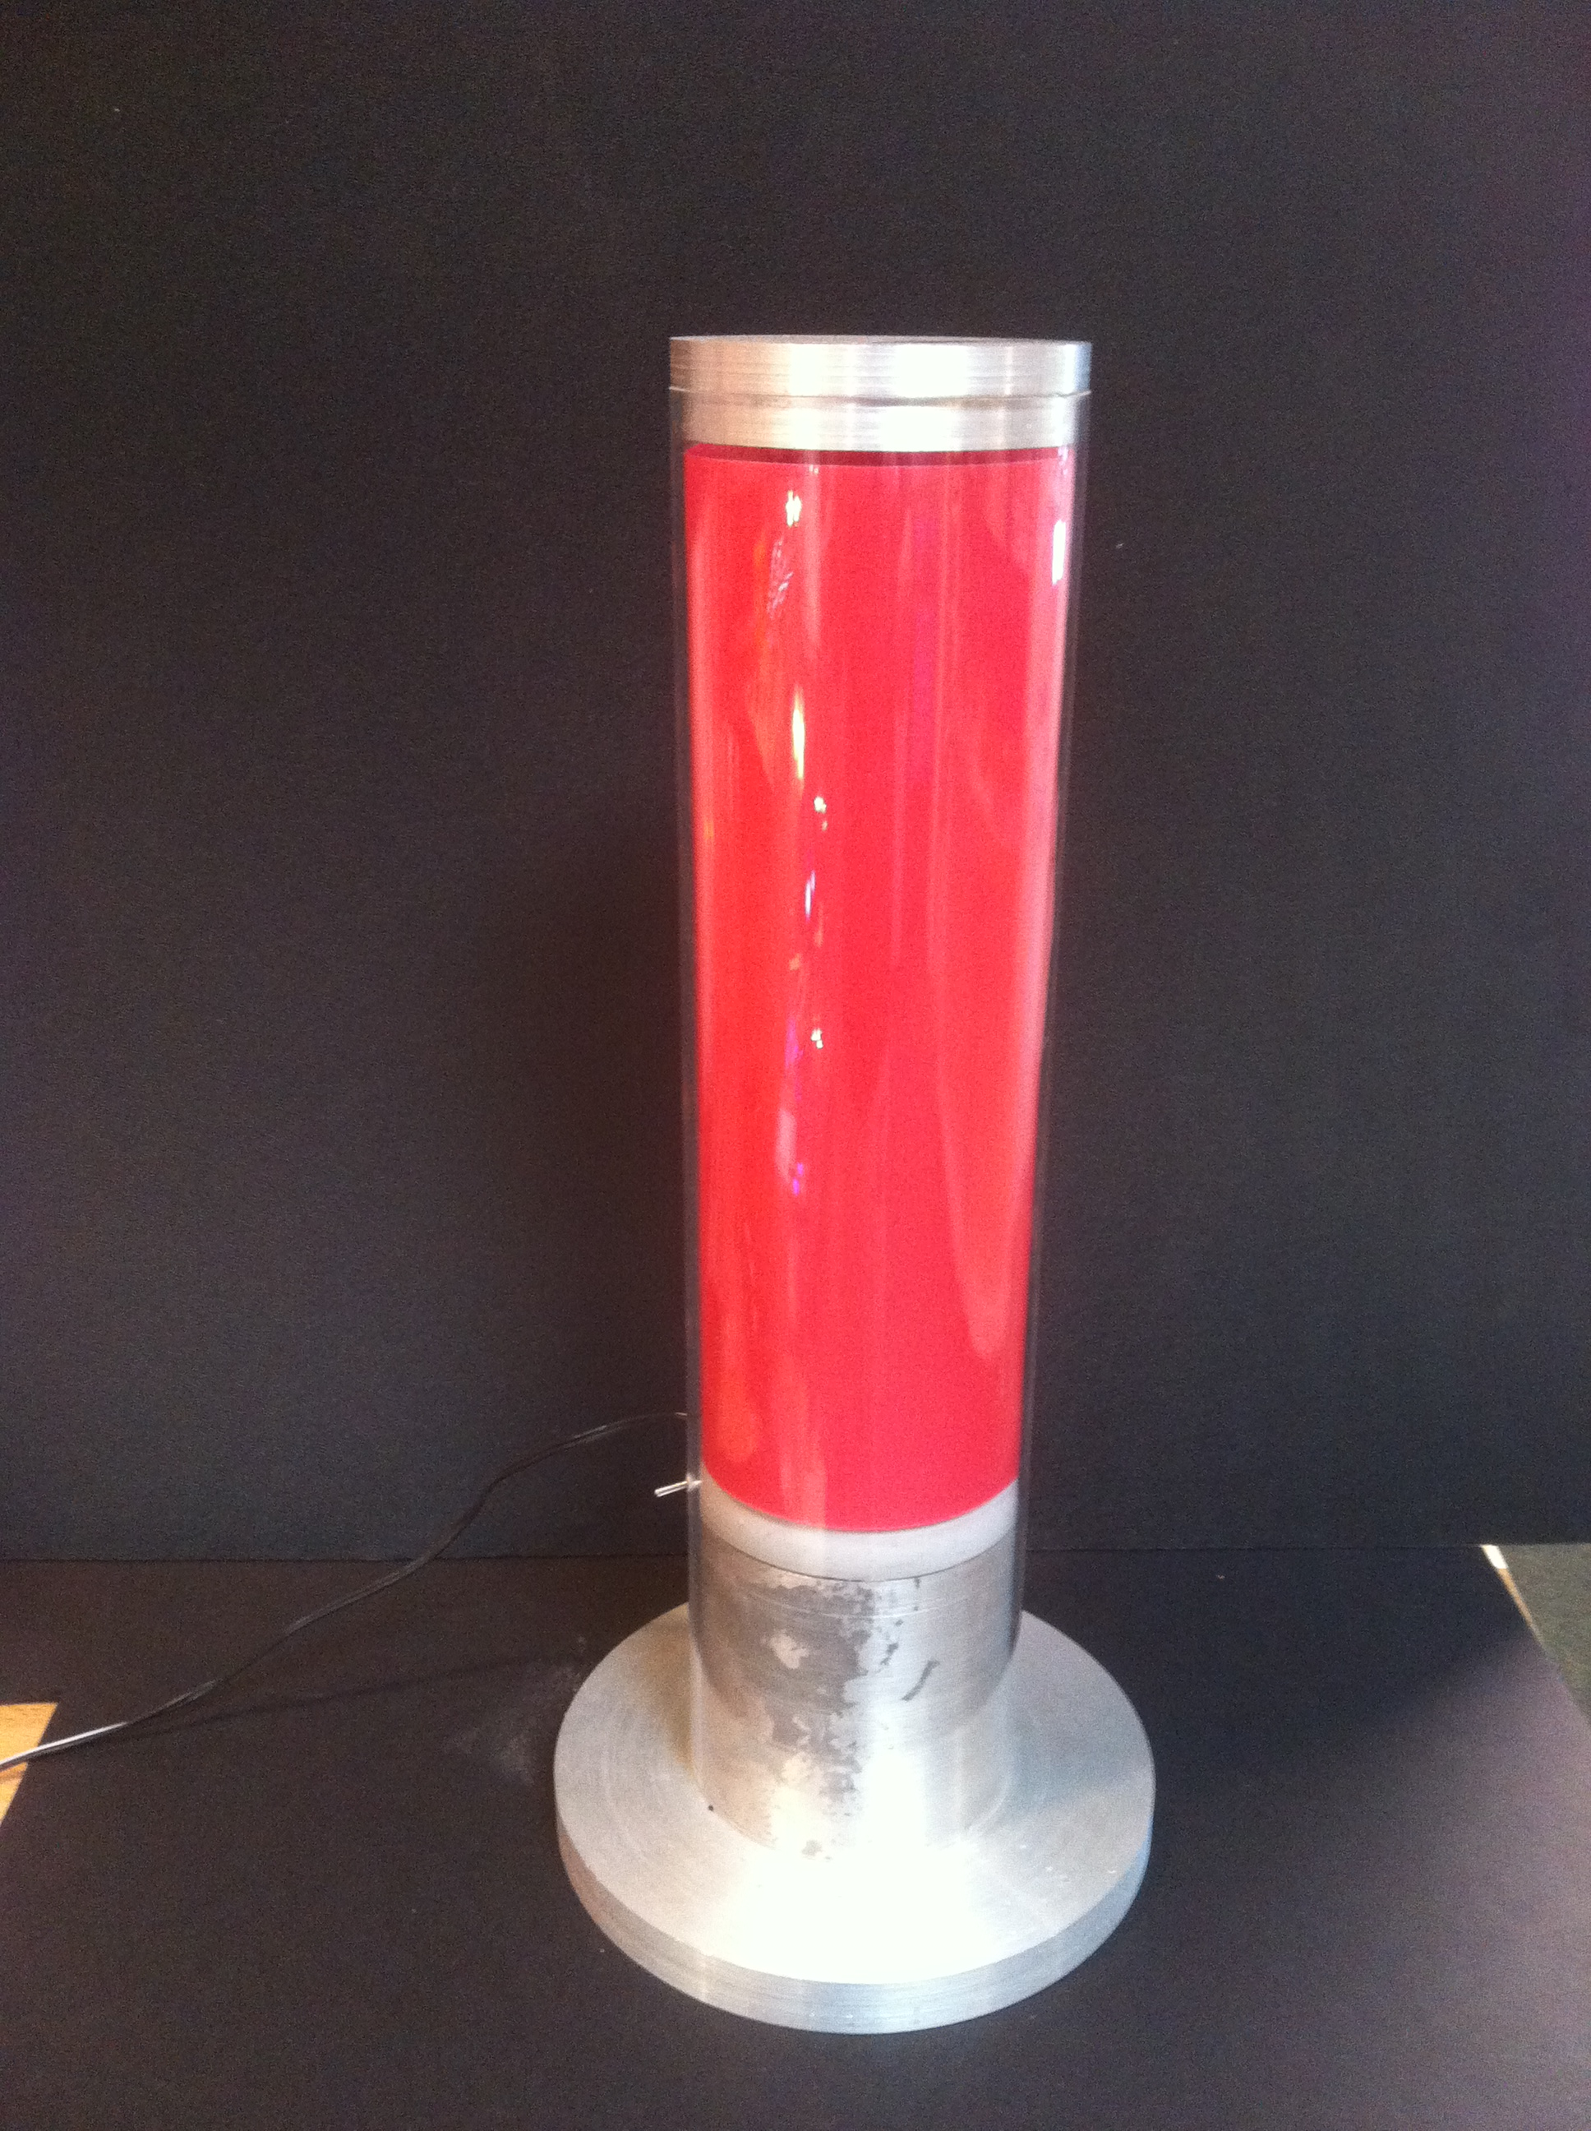
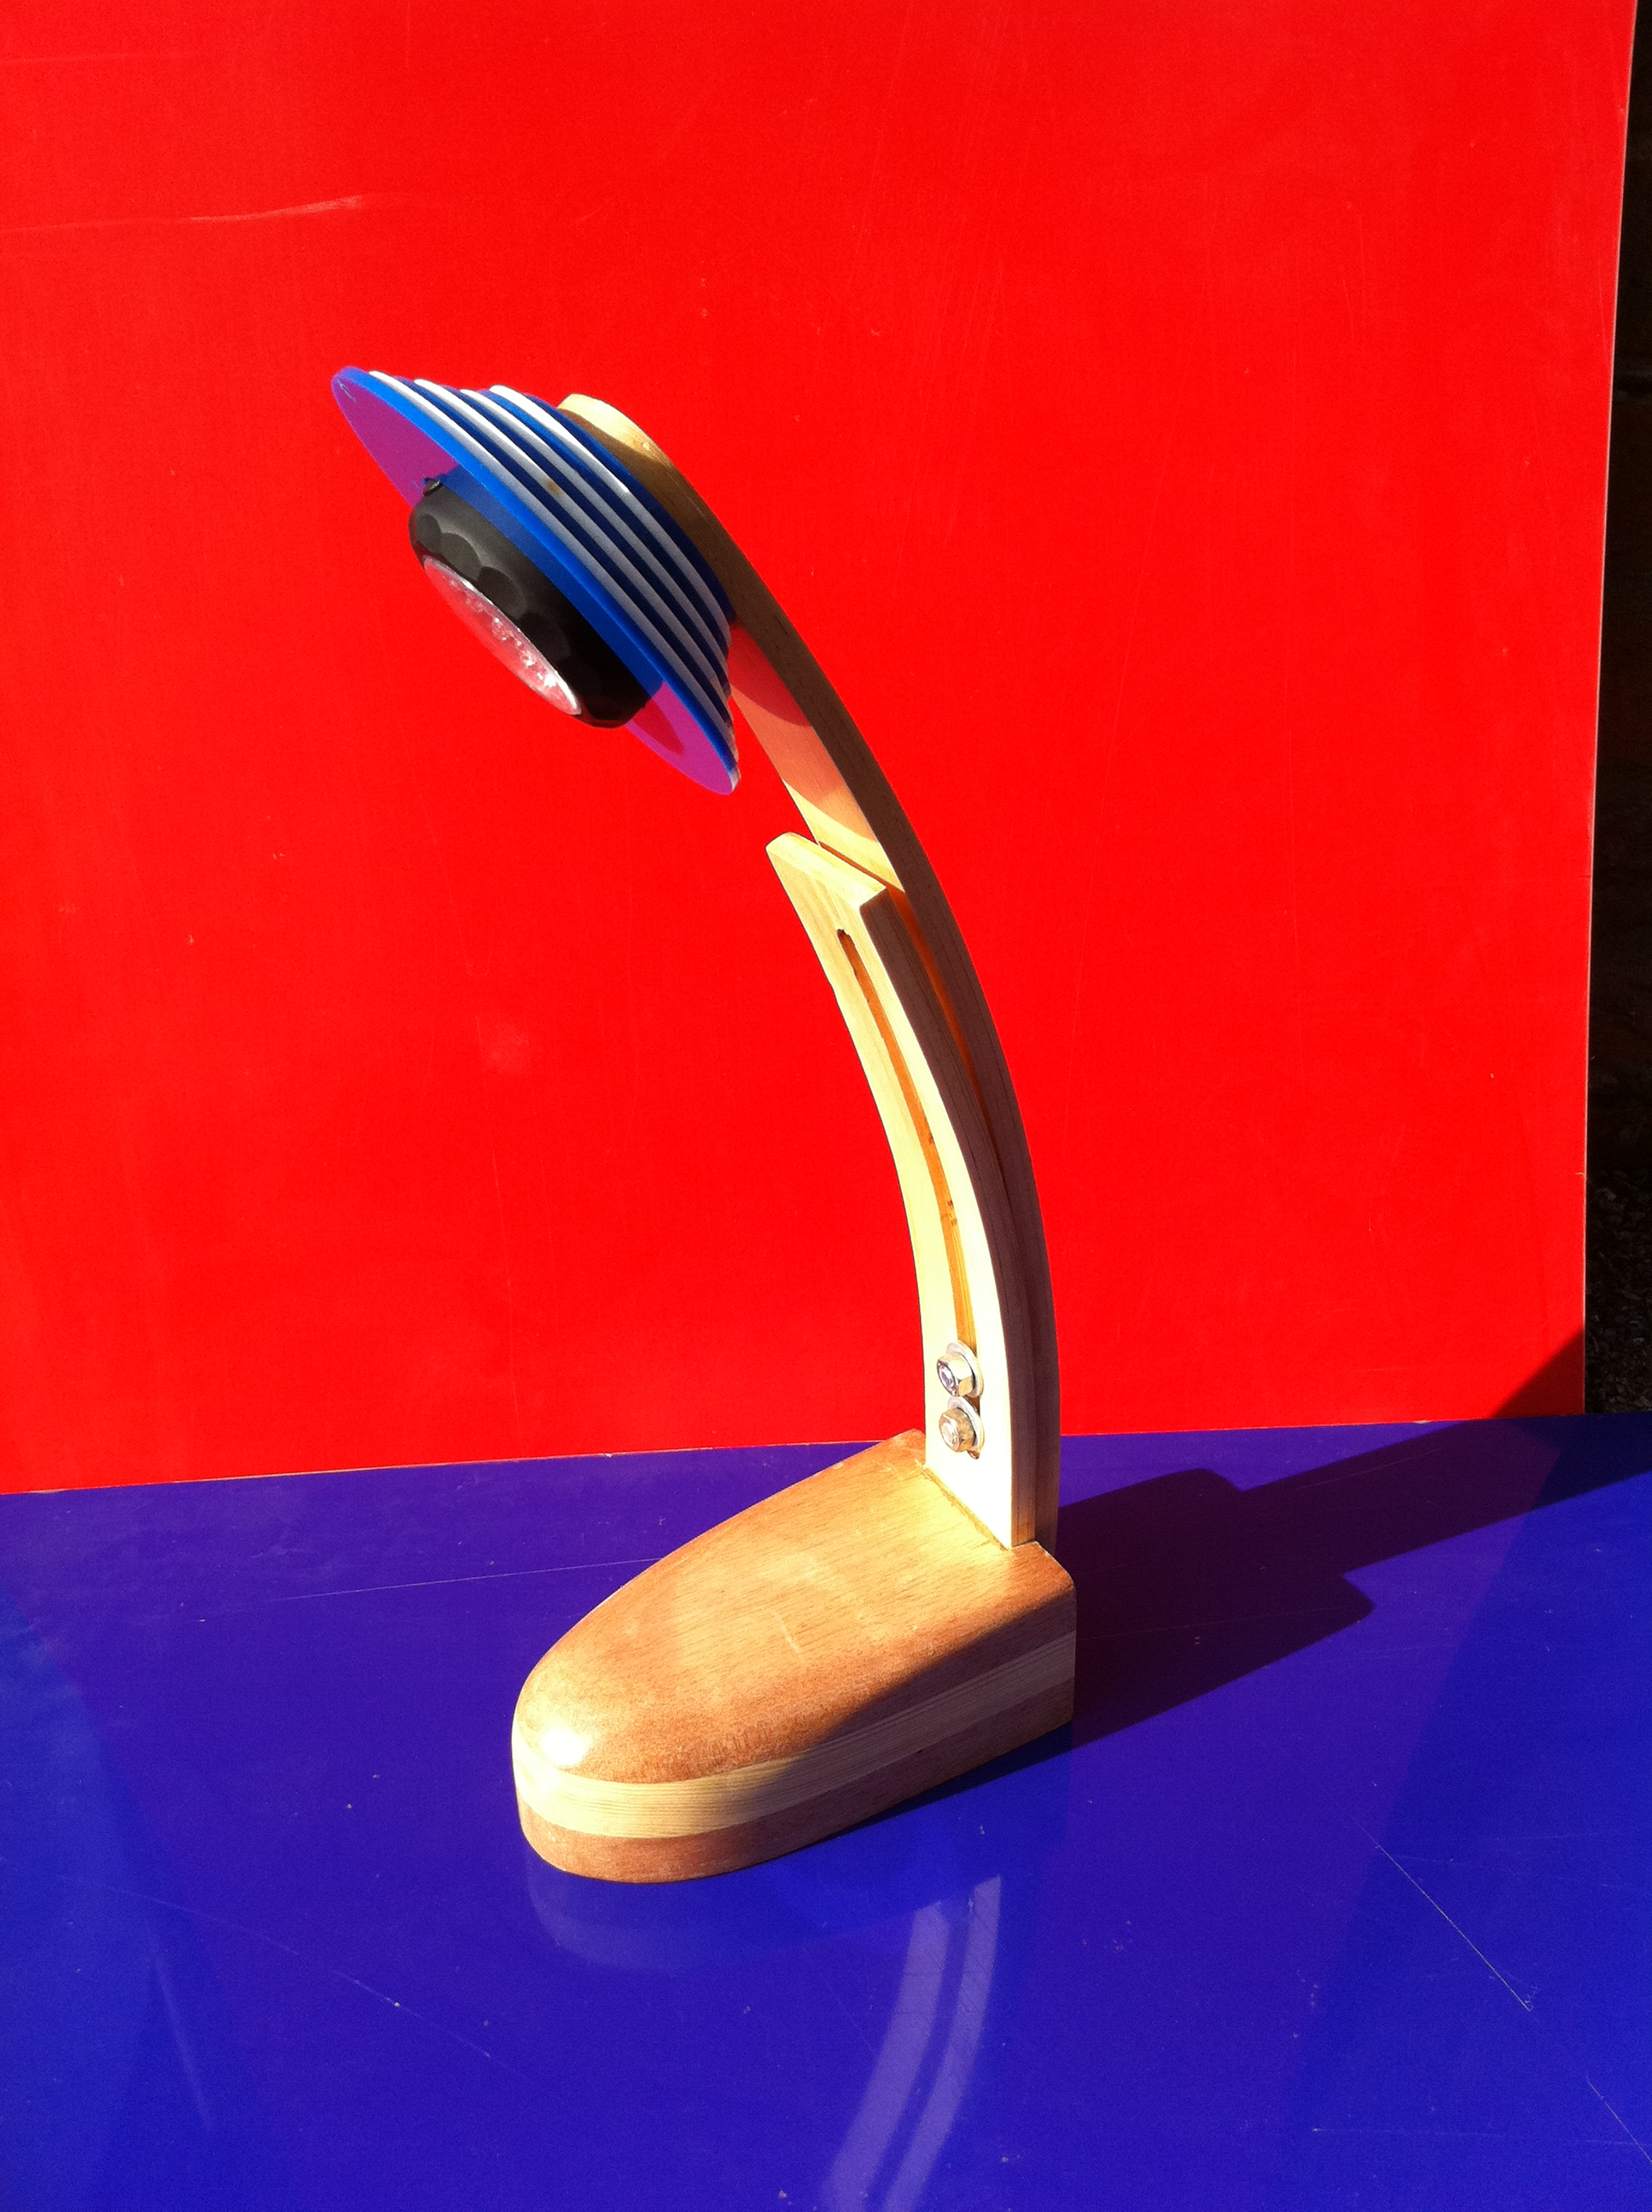
5.4 Final photos

